Slide 1
Image Compression
Domain: SVD

Slide 2
BACKGROUND
Multimedia content of digital information is increasing day by day. Transfer and Storage of data should be efficient.
Image compression - reducing number of bits to represent data while maintaining acceptable image quality.
A popular technique called SVD (Singular Value Decomposition) is used to compress image.
The SVD was discovered over 100 years ago independently by Eugenio Beltrami (1835–1899) and Camille Jordan (1838–1921), James Joseph Sylvester (1814– 1897), Erhard Schmidt (1876–1959), and Hermann Weyl (1885–1955).
QR decomposition is also used to help with SVD. The QR algorithm was developed by John Francis and by Vera Kublanovskaya, both working independently.

Slide 3
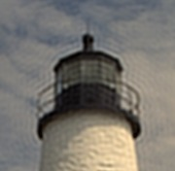
MOTIVATION
To accomplish image compression in more efficient way than other algorithms as:
Comparison speed is high
More stable
Allows us to perform optimization on memory reduction(unlike fourier transform)
Does not lead to the ringing artifacts

Slide 4
Compressing an image while keeping an appropriate balance between compression ratio and quality.
Problem Statement

Slide 5
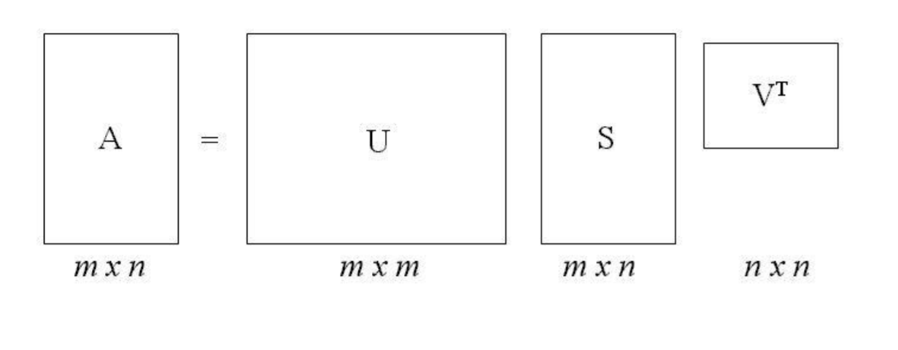
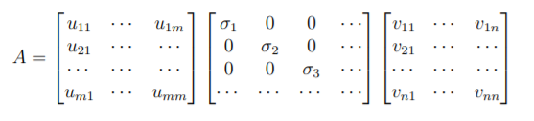
Basic Mathematics
Image Matrix A
decomposed into U, S and Vᵀ matrices with both U and V being orthogonal matrices and S is a diagonal matrix composed of singular values of A in decreasing order

Slide 6


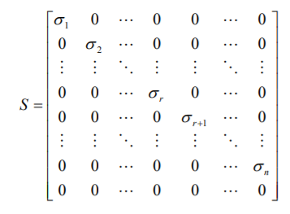

Basic Mathematics
Matrix U = [u₁, u₂, u₃ ,......, uₘ]
column vectors uᵢ , for i = 1, 2, …, m, form an orthonormal set:
Matrix V = [v₁, v₂, v₃ ,......, vₙ]
column vectors vᵢ , for i = 1, 2, …, n, form an orthonormal set:
Diagonal matrix S has singular values such that:
For i = 1, 2, …, σₙ
r = rank of matrix

Slide 7

Basic Mathematics
The QR algorithm is an algorithm used to calculate eigenvalues and eigenvectors of a matrix.
A is the real matrix of which we want to compute the eigenvalues.
QR decomposition of where Q is an orthogonal matrix and R is an upper triangular matrix.
So, all Ak are similar and have the same eigenvalues.

Slide 8
Literature Survey
From research paper of Mrs. Rehna V.J and Mr. Abhranil Dasgupta:
Image Compression is done by removing these redundancies:
Coding redundancy
Spatial/Interpixel redundancy
Psychovisual redundancies-Irrelevant information (data that is ignored by the human visual)

Slide 9
Literature Survey
Compression Ratio is the ratio of the storage space required to store original image to that required to store a compressed image and is given by
Compression Ratio = m*n / (k*(m+n+1))
The Eigenvectors of a square matrix are the non-zero vectors that change only in magnitude, not in direction.
SVD is lossy compression (compressing image but some information will be lost)
Lost information cannot be recovered

Slide 10
Properties of SVD
The singular value σ₁, σ₂, …, σₙ are unique, however, the matrices U and V are not unique.
As AᵀA = VSᵀSVᵀ, so V diagonalizes AᵀA, it follows that the vⱼ’s are the eigenvector of AᵀA.
As AAᵀ = USSᵀUᵀ , so it follows that U diagonalizes AAᵀ and that the uⱼ’s are the eigenvectors of AAᵀ.
If A has rank of r then vⱼ, vⱼ, …, vᵣ form an orthonormal basis for range space of Aᵀ, R(Aᵀ) and uⱼ, uⱼ, …, uᵣ form an orthonormal basis for range space A, R(A).
The rank of matrix A is equal to the number of its nonzero singular values

Slide 11



SVD Methodology
While compressing the above sum is not performed till the very last term.
Instead sum is taken till first “k” term,

Slide 12
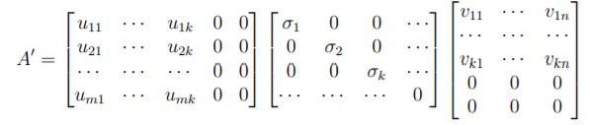
Literature Survey
“ k ”
take the largest k elements along the diagonal and set others to 0.
set to 0 - columns in U and rows in Vᵀ with index larger than k.

Slide 13


Literature Survey
Memory
Compression ratio
Original Image= m x n
Compressed Image=
k (m + n + 1)
U ( m x k )= mk values
V^T (n x k )= nk values
S( k x k) = k values
A1 = mk + nk + k
= k(m+n+1)
Mean Square Error (MSE)
To measure the quality between original image and compressed image

Slide 14
Literature Survey
From a research paper by Miss Samruddhi Kahu and Ms. Reena Rahate,
Lower singular values carrying no or little information can be eliminated without causing severe visual distortion.
Value of k(number of eigenvalues used to compress and reconstruct an image) is related to image quality and compression ratio.
Smaller k → higher compression ratio → more degradation in image and vice versa
For compressing image,
m*n > k*(m+n+1)

Slide 15
Literature Survey
Concept of QR decomposition is also used in finding the eigenvalues and eigenvectors.
Finding eigenvalues of matrices with dimensions greater than 2x2 becomes tedious, and that is why QR decomposition is used.
In this method, we decompose a matrix A into an orthogonal matrix Q and an upper triangular matrix R.

Slide 16
Reproduced Work
Matlab Simulation
Image into grayscale format
Image data → matrix of each pixel (value 0-255)
Computation of SVD operations on matrix
Computation of errors and displaying error graph
Output as compressed images with different singular values taken at each time.

Slide 17
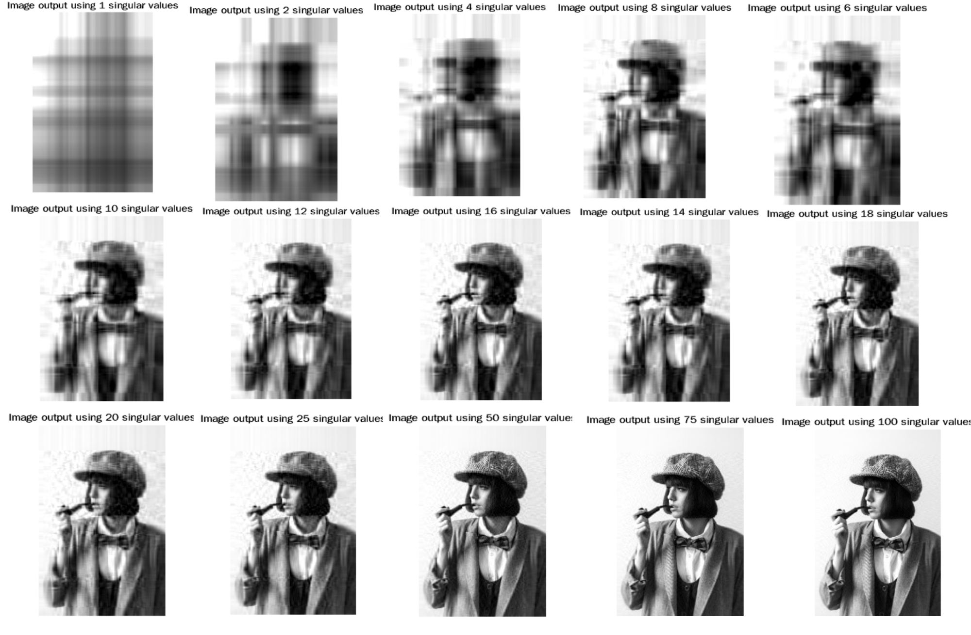
Compressed Images (different k values)

Slide 18
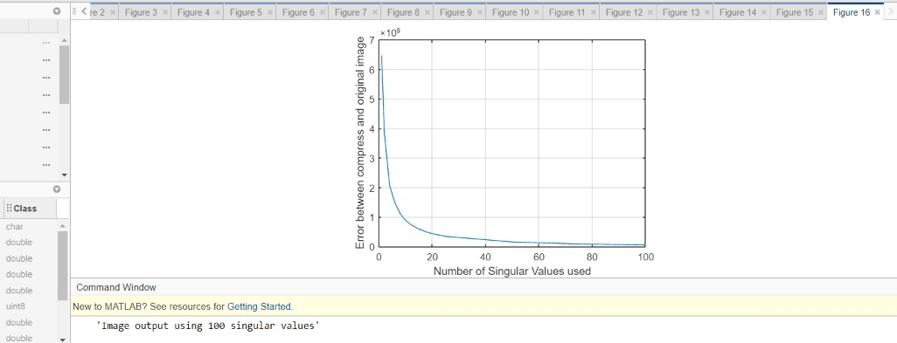
Graph
Error vs Number of singular values used

Slide 19
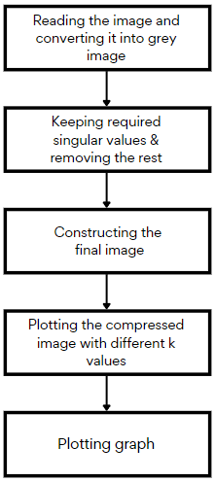
Flowchart for MATLAB

Slide 20
RGB Image compression using python
Taking image as input and then separating RGB components
QR decomposition is applied to find eigenvectors and eigenvalues.
Calling SVD function to perform and then reconstructing the matrix
Calculation of MSE.

Slide 21
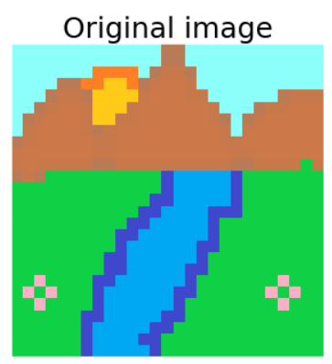
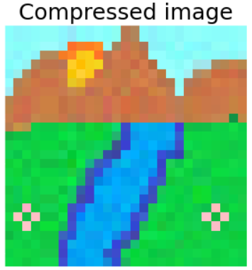
RGB Image Compression

Slide 22
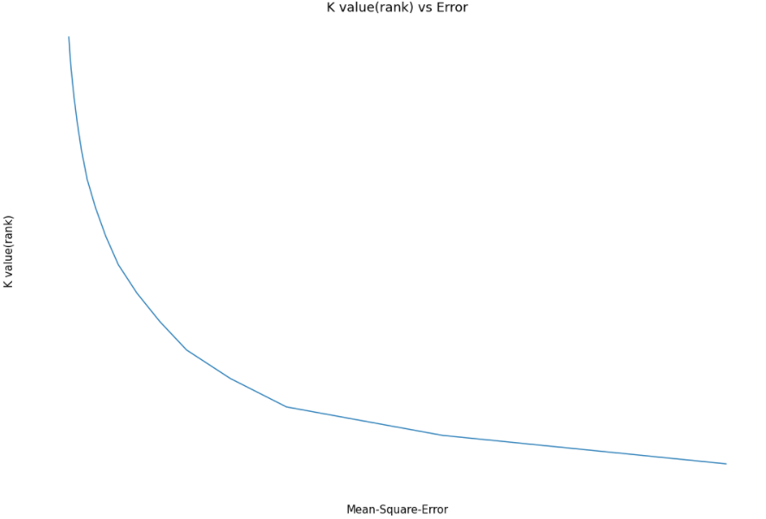

RGB Image Compression Graph
Graph: k vs MSE

Slide 23
Flowchart
Taking image as input and separating its RGB components
Finding eigenvalues and eigenvectors using QR decomposition
Performing SVD on component matrices
Regenerating matrix components and combining them & calculation of MSE
Using k values and removing values greater than k
Output :
Compressed image

Slide 24
References
1. Jameela, Rehna. (2011). JPEG Image Compression using Singular Value Decomposition. IOSR Journal of Electrical and Electronics Engineering. 1. 81 - 88.
2. Kahu, S. and Rahate, R., 2013. Image Compression using Singular Value Decomposition. [ebook] SciResPub., pp.244-248. Available at: <http://www.ijoart.org/docs/Image-Compression-using-Singular-Value-Decomposition.pdf> [Accessed 28 September 2021].
3.Singular value decomposition applied to digital image ... (n.d.). Retrieved October 20, 2021, from https://sites.math.washington.edu/~morrow/498_13/svdphoto.pdf.
4. Image compression using singular value ... - math. (n.d.). Retrieved October 20, 2021, from https://www.math.utah.edu/~goller/F15_M2270/BradyMathews_SVDImage.pdf.

Slide 25
Thank You

